Slide 1
License plate detection
Digital Image Processing
TY CSE
Submitted by
2017BTECS00089
2017BTECS00085
2017BTECS00087

Slide 2
Problem statement- For given digital Image extract the license plate of a car

Slide 3
Method
Project is developed using python and opencv
No use of ML .
It is based on contour in opencv
Dosent give numbers directly it just highlights (gives you the coordinate ) the rectangular area of number plate in image.
Imutils is used
Steps involved
1) Image thresholding
2)Canny edge detection
3) dilation of image

Slide 4
Imutils
It is a series of convenience functions
makes basic image processing functions such as translation, rotation, resizing, skeletonization
Also helps in displaying Matplotlib images easier with OpenCV and both Python 2.7 and Python 3.

Slide 5
Thresholding
Here, if the pixel value is greater than a threshold value, it is assigned one value (may be white), else it is assigned another value (may be black).
The function used is cv2.threshold.
First argument is the source image, which should be a grayscale image.
Second argument is the threshold value which is used to classify the pixel values.
Third argument is the maxVal which represents the value to be given if pixel value is more than (sometimes less than) the threshold value.
OpenCV provides different styles of thresholding and it is decided by the fourth parameter of the function.
For this project we have used cv2.THRESH_BINARY

Slide 6
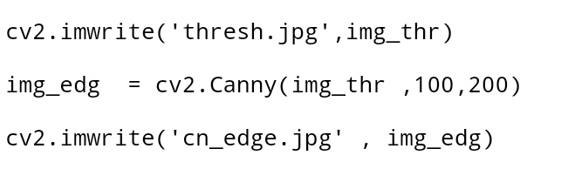
Canny edge detection
OpenCV has function cv2.Canny().
First argument is our input image.
Second and third arguments are our minVal and maxVal respectively.
Third argument is aperture_size. It is the size of Sobel kernel used for find image gradients. By default it is 3.
Last argument is L2gradient which specifies the equation for finding gradient magnitude. If it is True, it uses the equation mentioned above which is more accurate, otherwise it uses this function: Edge\_Gradient \; (G) = |G_x| + |G_y|. By default, it is False.

Slide 7
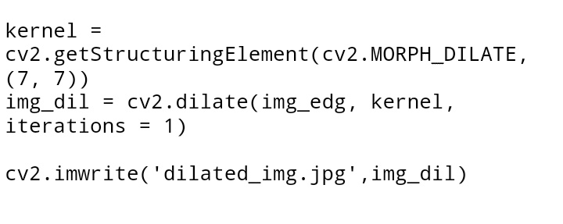
Dilation
We can perform the dilation operation on an image using the dilate() method of the imgproc class. Following is the syntax of this method.
dilate(src, dst, kernel)
This method accepts the following parameters −
src − A Mat object representing the source (input image) for this operation.
dst − A Mat object representing the destination (output image) for this operation.
kernel − A Mat object representing the kernel.

Slide 8
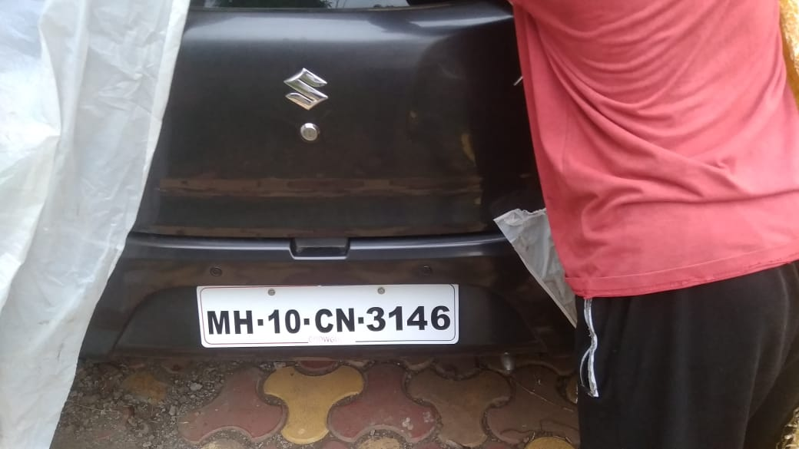
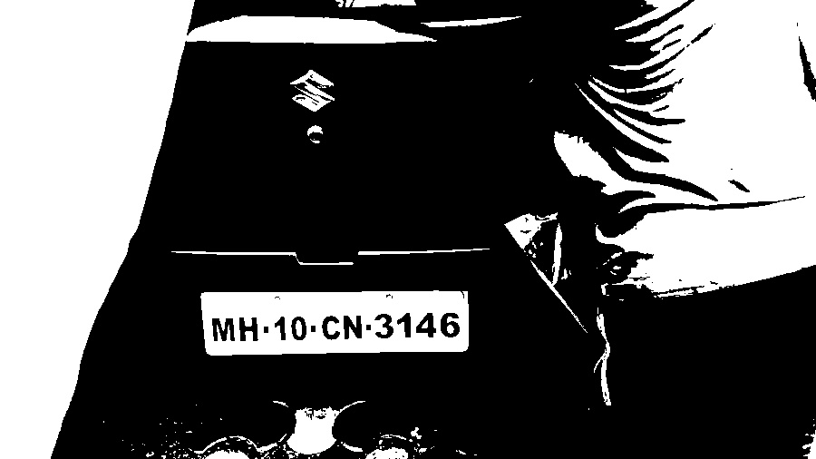
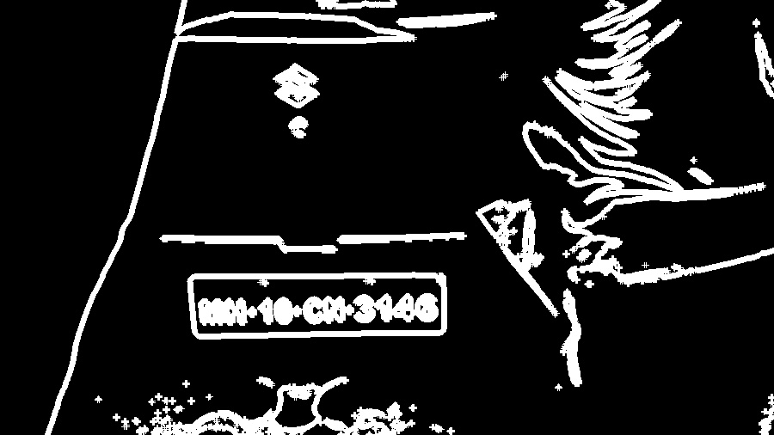
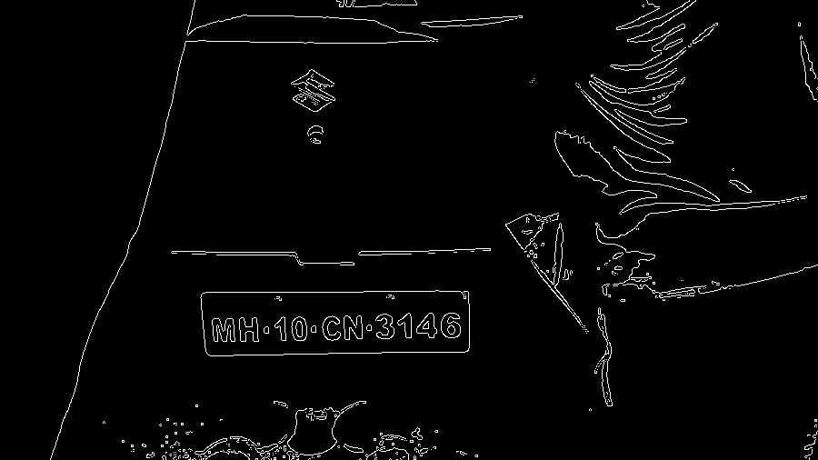
1)Input image
2) thresholding
4) dilation
3)Canny edge detection

Slide 9
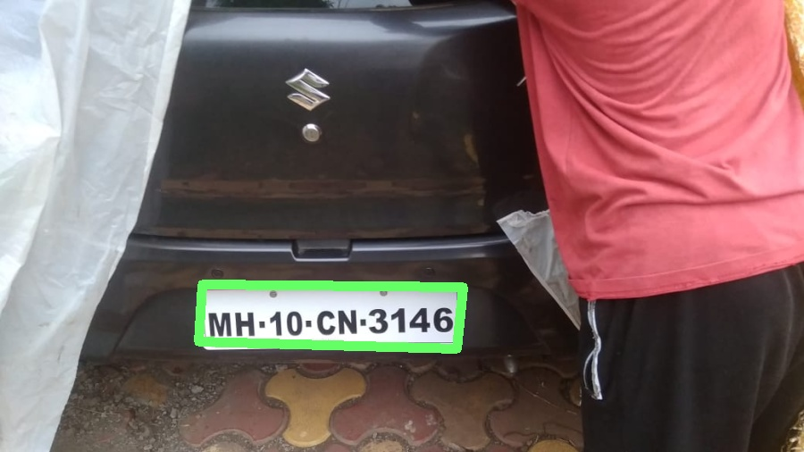

Detected license plate
Final output

